Slide 1
Improving Student Academic Performance Through Data Analytics
Project title: Student Academic Performance Analytics
Presented by: Rafiu Hammed Abiola
Mentor: Yusuf Godwin
Group: c3 adv. Data analysis & visualization 002
Deep_Tech/WESOnline Mentorship Program
Student Academic Performance Analytics | Deep_Tech/WESOnline Mentorship Program

Slide 2
Problem Statement
Schools collect large amounts of student data but often struggle to transform it into meaningful insights.
Educators may find it difficult to identify performance patterns and support students who need intervention.
This project addresses the need for data-driven academic decision-making.
Student Academic Performance Analytics | Deep_Tech/WESOnline Mentorship Program

Slide 3
Project Overview / Solution
Student Academic Performance Analytics cleans, analyzes, and visualizes student records to generate actionable insights.
The Power BI dashboard helps educators monitor KPIs, compare subject performance, identify trends, and support evidence-based decisions.
Student Academic Performance Analytics | Deep_Tech/WESOnline Mentorship Program

Slide 4
Tools & Technologies
Python (Pandas, Matplotlib) – Data cleaning and exploratory analysis
SQL – Data querying and analysis
Excel & Power Query – Data preparation
Power BI – Dashboard development and visualization
GitHub – Documentation
Student Academic Performance Analytics | Deep_Tech/WESOnline Mentorship Program

Slide 5
Methodology / Implementation
1. Business Understanding
2. Data Understanding and Profiling
3. Data Cleaning and Quality Assessment
4. Exploratory Data Analysis
5. KPI Definition
6. Power BI Dashboard Development
7. Insights and Recommendations
Student Academic Performance Analytics | Deep_Tech/WESOnline Mentorship Program

Slide 6
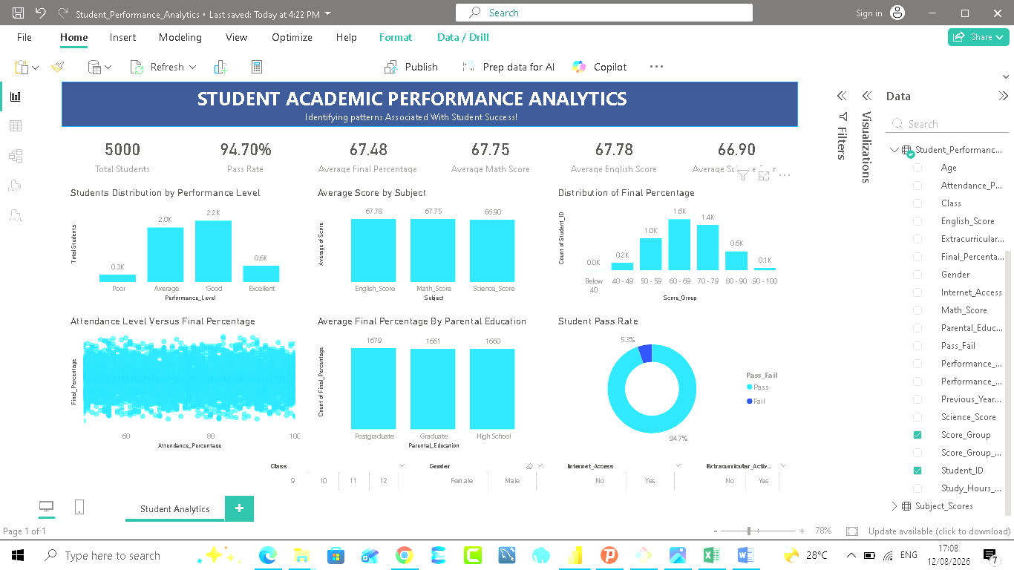
Results / Demo
Key Results:
5,000 students analyzed
Pass Rate: 94.70%
Average Final Percentage: 67.48%
60.70% of students scored between 60–79%
Subject performance was relatively balanced
Demo: Interactive dashboard showing KPIs, distributions, subject analysis, and attendance relationship.
Student Academic Performance Analytics | Deep_Tech/WESOnline Mentorship Program

Slide 7
Conclusion
Data analytics supports better educational decisions.
No single available variable showed a strong linear relationship with final performance.
Student success is influenced by multiple factors.
Future Improvements:
Add richer educational data
Develop predictive analytics
Expand school applications.
Student Academic Performance Analytics | Deep_Tech/WESOnline Mentorship Program

